Slide 1
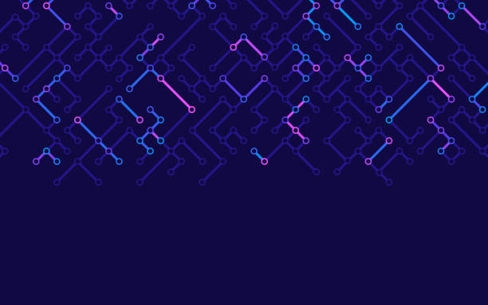

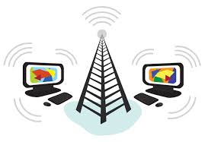
What is internet and WWW (World wide web)

Slide 2
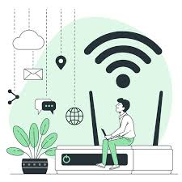
The Internet is a global network of interconnected computers and devices that communicate with each other to exchange data and information. It allows people to share resources, access websites, communicate via email, participate in social media, stream videos, play online games, and much more.
At its core, the Internet uses a system of protocols called TCP/IP (Transmission Control Protocol/Internet Protocol) to ensure that data is transmitted reliably between devices across vast distances. The Internet is not controlled by any single entity but is a decentralized network made up of millions of smaller networks—ranging from personal home Wi-Fi setups to large corporate and governmental infrastructures.

Slide 3
Some key features of the Internet include:
World Wide Web (WWW): A vast collection of websites and online content that you can access using web browsers like Chrome, Firefox, or Safari. The web is just one part of the Internet, alongside other services like email, file sharing, and voice or video calling.

Slide 4
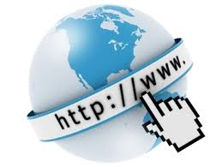
The World Wide Web (WWW) is a system of interlinked hypertext documents and media (such as text, images, videos, and audio) that are accessed via the Internet. It is essentially the part of the Internet that most people interact with daily, accessed through web browsers like Google Chrome, Safari, or Firefox.

Slide 5
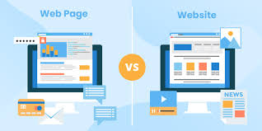
Here’s a breakdown of what the World Wide Web is and how it works:
1. Web Pages and Websites:
The World Wide Web consists of websites made up of individual web pages. Each page can contain various types of content like text, pictures, and links to other pages.
Websites are hosted on web servers, which are computers that store and serve web content to users when requested.

Slide 6
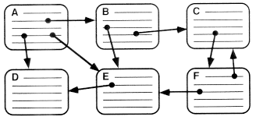
2. Hypertext:
A key feature of the Web is hypertext, which allows users to navigate between different documents by clicking on hyperlinks. These links can lead to other pages on the same website or to completely different sites on the Web.
This interconnectedness forms the "web" in the World Wide Web.

Slide 7
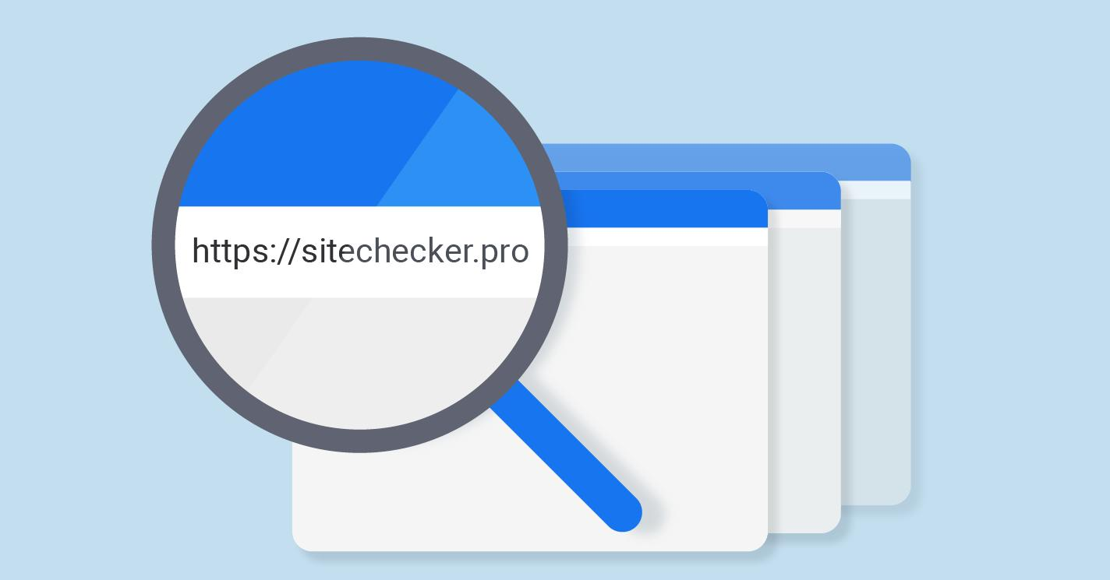
3. URLs (Uniform Resource Locators):
Each web page is identified by a URL (web address), such as https://www.example.com. The URL is a unique string that points to a specific resource on the web, allowing browsers to retrieve it.

Slide 8
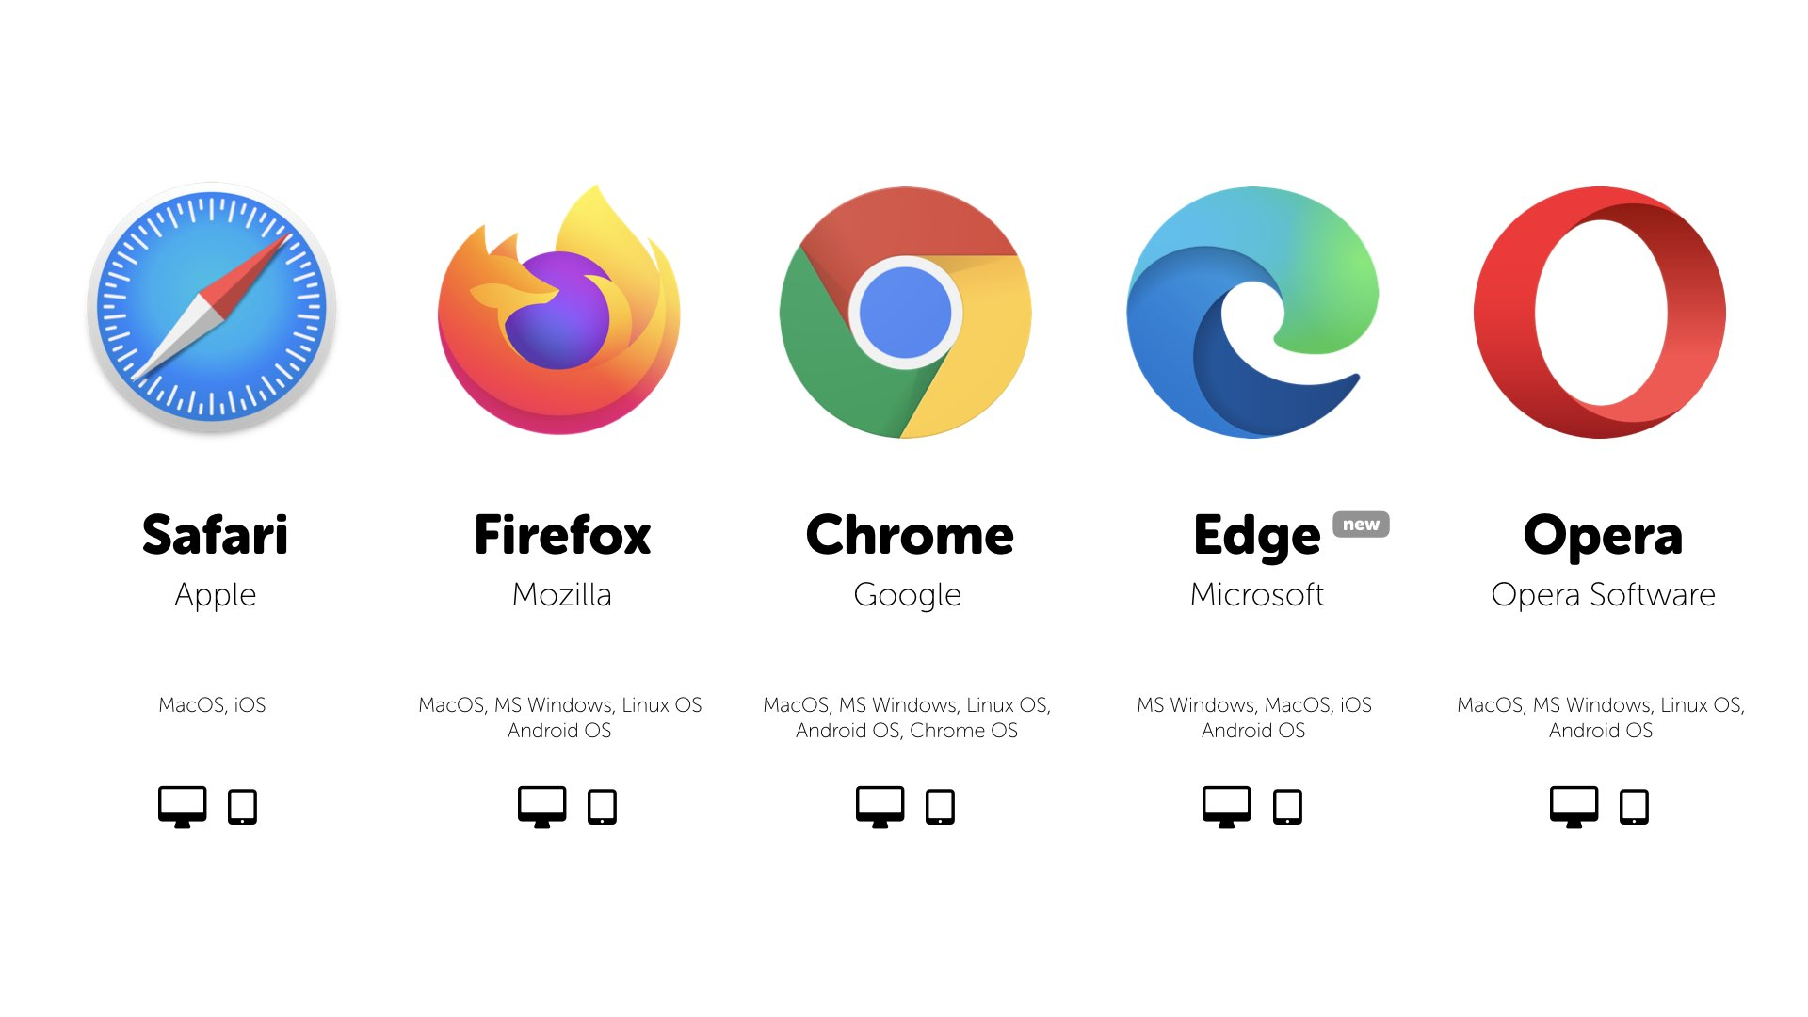
4. Web Browsers:
To access the Web, you use a web browser (like Google Chrome, Mozilla Firefox, Safari, or Microsoft Edge). A browser retrieves and displays web pages by interpreting HTML (Hypertext Markup Language), CSS (Cascading Style Sheets), and JavaScript—languages that define the structure, design, and behavior of websites

Slide 9
Internet (Summary):
The Internet is a global network of interconnected computers and devices that communicate with each other to exchange data. It allows access to a wide variety of services like websites, email, online gaming, file sharing, and more. The Internet uses standard communication protocols (like TCP/IP) to ensure data can be transmitted reliably across vast distances, connecting millions of networks worldwide.

Slide 10
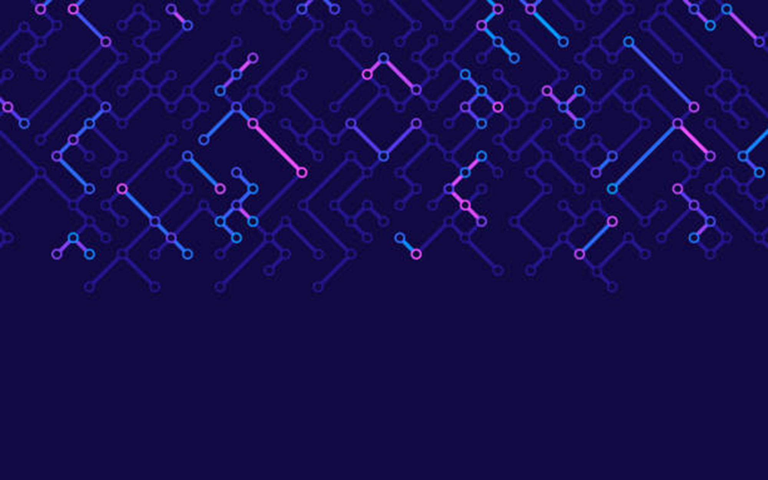
Web Browser (Summary):
A web browser is a software application that enables users to access and view content on the World Wide Web (WWW). Popular web browsers include Google Chrome, Mozilla Firefox, Safari, and Microsoft Edge. Browsers interpret and display web pages, which are made of text, images, and multimedia, by requesting information from web servers over the Internet using HTTP (Hypertext Transfer Protocol).

